Slide 1
Error Checking

Slide 2
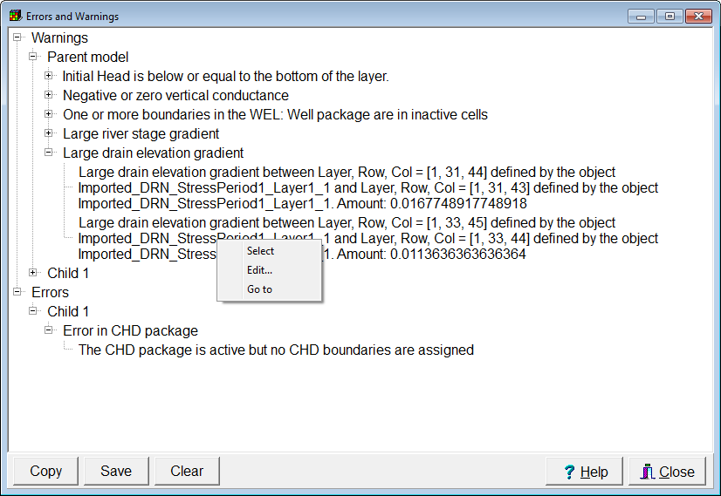
Error Checking by ModelMuse
Notes:
Note the pop-up menu

Slide 3
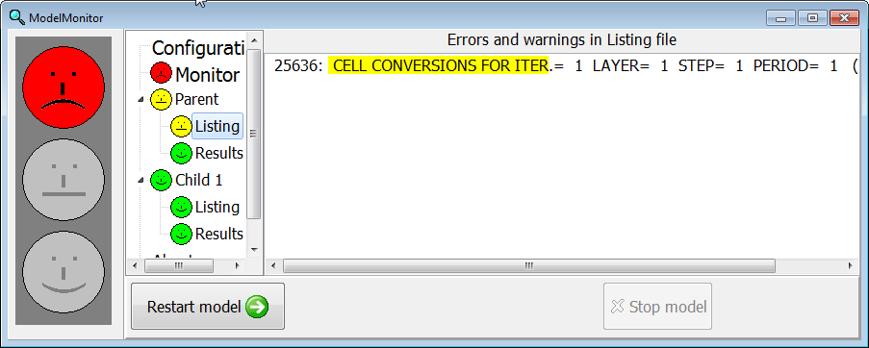
Warnings and Errors from MODFLOW

Slide 4
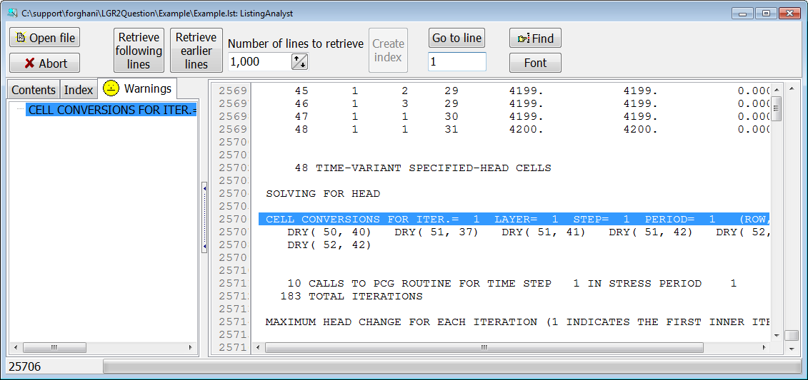
Use ListingAnalyst to See Errors and Warnings in More Detail

